Slide 1
DCS530 Term Project
An Analysis of Social Media Engagement: Likes, Retweets, and Sentiment
Justin Pizzoferrato
DCS530
Professor Metzger
16 November 2025

Slide 2
Statistical Question
Question:
What factors contribute to the virality of social media posts, and how do attributes such as platform, sentiment, and hashtags influence engagement metrics like likes and retweets?
Hypothesis:
Sentiment and hashtags are the strongest predictors of high engagement on social media, while platform differences moderate the effect.

Slide 3
Data Set Overview
Dataset Source: Kaggle Social Media Sentiment Dataset.
Size: 10,000 rows, 8 columns
Purpose: Analyze engagement patterns on Twitter, Instagram, and Facebook
Variables:
1. Platform: The social media platform (categorical)
2. Sentiment: Emotional tone of posts (categorical)
3. Likes: Number of likes (numerical)
4. Retweets: Number of retweets (numerical)
5. Hashtags: Keywords associated with posts (categorical)

Slide 4
Variable Descriptions
Platform: The platform where posts were shared (Twitter, Instagram, Facebook)
Sentiment: Categories of emotional tone (Positive, Neutral, Negative)
Likes: Number of likes as a measure of user approval
Retweets: Number of retweets, indicating content amplification
Hashtags: Contextual keywords used in posts for searchability

Slide 5
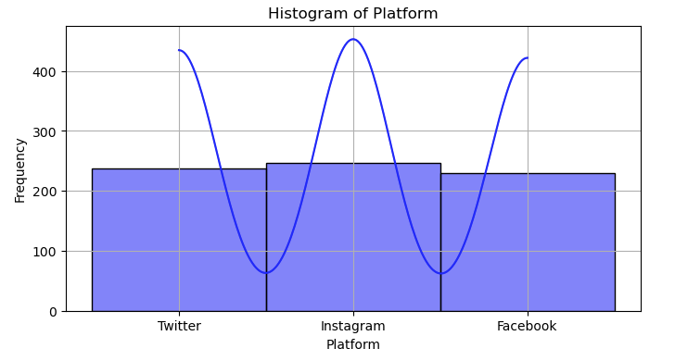
Histogram of Platform
Instagram is the most prevalent dataset, while Facebook has the lowest representation

Slide 6
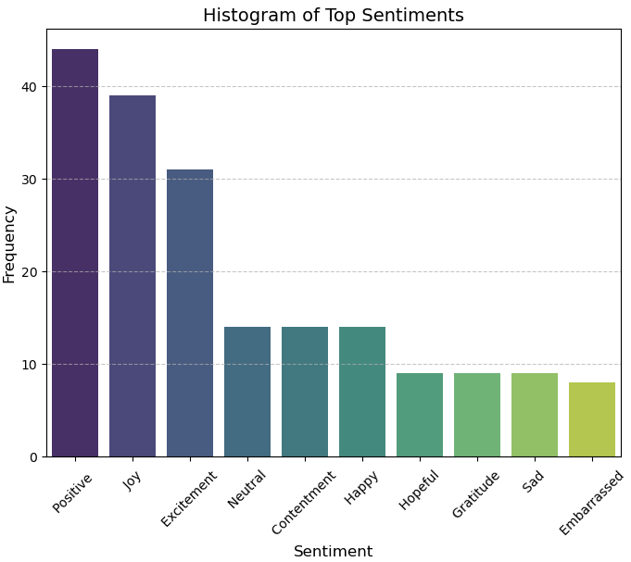
Histogram of Sentiment
Positive sentiment is most frequent, followed by neutral, with few negative posts

Slide 7
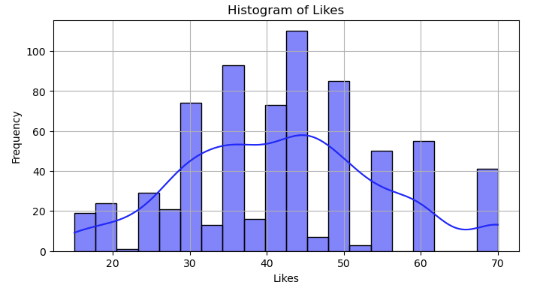
Histogram of Likes
Normally distributed around 40 likes, with a few posts receiving very high likes

Slide 8
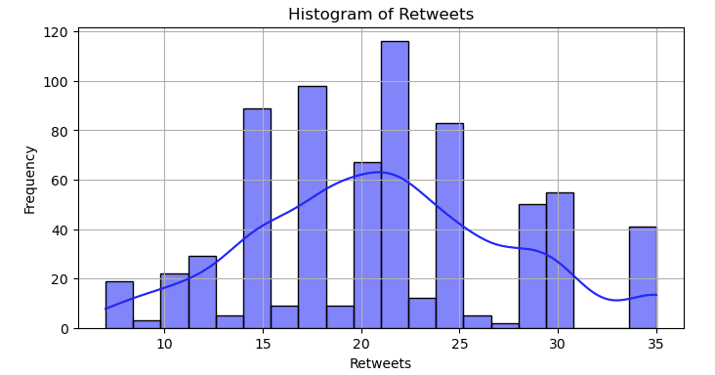
Histogram of Retweets
Right-skewed, indicating fewer posts receive high retweets.

Slide 9
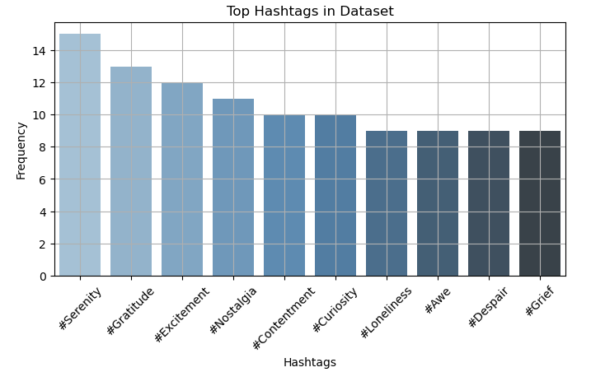
Histogram of Hashtags
The most frequent hashtags are #serenity, #gratitude, and #excitement

Slide 10
Analysis of Outliers
Identification of Outliers:
Likes and Retweets: Outliers in these variables were identified by inspecting the tails of their histograms and examining values significantly deviating from the mean and standard deviation. For instance, while the majority of Likes and Retweets fell within a concentrated range, there were extreme values that appeared well above the upper quartiles.
Hashtags: The histogram of hashtags showed some posts with exceptionally high numbers of hashtags, potentially indicating promotional or spam-like behavior.
Sentiment: While sentiment scores are categorical, rare or unusual sentiments (e.g., “Embarrassed”) were noted as potential outliers because they occur infrequently in the dataset.
Analysis of Outliers:
Outliers in Likes and Retweets often correspond to viral posts or events that garnered disproportionately high engagement. These are valuable data points for understanding virality but may skew statistical summaries such as the mean and standard deviation.
For Hashtags, posts with excessive hashtags might reflect aggressive marketing strategies or spammy behavior. These data points can distort the analysis of genuine user behavior and content virality.
Handling Outliers:
Retained for Contextual Insight: Outliers in Likes and Retweets were retained in the dataset since they represent critical insights into the factors contributing to high engagement. Instead of removal, their influence was carefully analyzed using measures like the mean, median, and spread.
Filtering for Specific Analysis: For hashtags, the analysis focused on the top 10 most frequently occurring hashtags to ensure meaningful insights. Posts with excessively high hashtag counts were excluded from visualization to avoid distortion.
Categorical Variables: Outliers in categorical variables, such as rare sentiments, were retained to provide a comprehensive view of sentiment diversity.
Impact of Outliers:
The outliers highlight the variability in user engagement across platforms and sentiments. While they do skew certain descriptive measures, their inclusion ensures that the dataset reflects real-world engagement patterns, including viral events and promotional strategies.

Slide 11
Descriptive Statistics
Likes:
Mean: 42, Mode: 45, Min: 15, Max: 70, Spread: 55
Retweets:
Mean: 21, Mode: 22, Min: 7, Max: 35, Spread: 28
Sentiment:
Mode: Positive, Spread: Balanced distribution
Outliers:
Posts with very high likes/retweets may indicate virality and require further attention

Slide 12
PMF Analysis
Platform | PMF
Instagram | 0.4248366013
Twitter | 0.2941176470
Facebook | 0.2810457516
Scenarios Compared:
High-engagement posts (top 25% likes and retweets) vs all posts
Findings:
Instagram dominates high engagement (42%)
Twitter with 29% is roughly equal with Facebook at 28%
Suggests Instagram posts are more likely to go viral

Slide 13
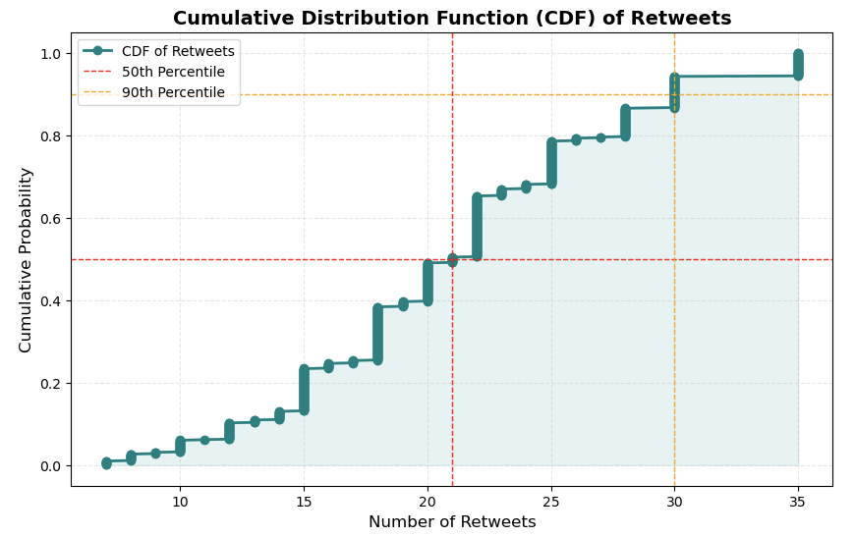
CDF of Retweets
Observation:
80% of posts receive fewer than 30 retweets
Long tail for viral posts indicates only a few posts achieve significant amplification
Implication:
Highlights the rarity of virality, aligning with the research question

Slide 14
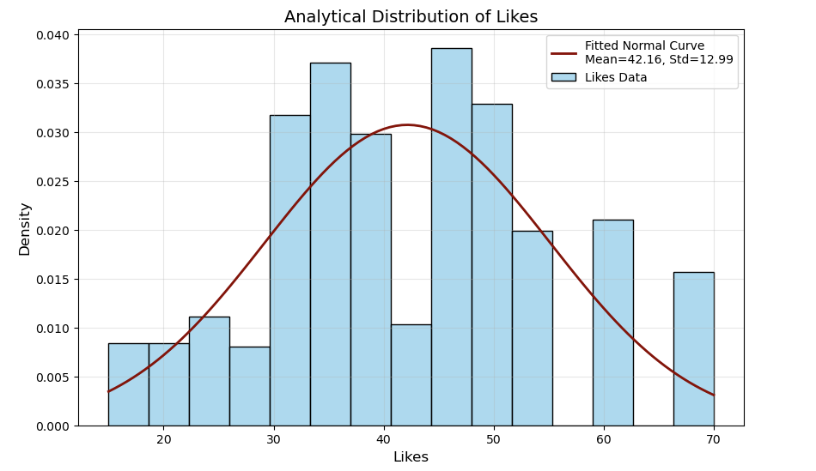
Analytical Distribution
Distribution Shape:
Approximately normal with a mean of 42
Analysis:
The fitted curve suggests predictable user engagement, with occasional viral outlier

Slide 15
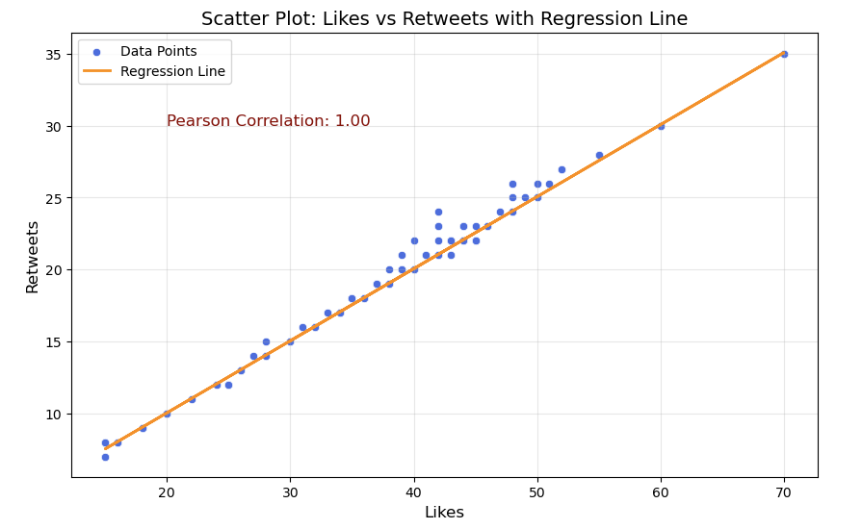
Scatter Plot Analysis
Likes vs Retweets:
Strong positive correlation (Pearson’s r = 1.00)
Indicates that posts with more likes also receive more retweets
Platform vs Likes:
Variability observed, with Instagram posts showing higher average likes

Slide 16
Hypothesis Testing
Test Used: ANOVA
F-statistic: 3.95, p-value: 0.00
Conclusion:
Sentiment significantly affects likes
Positive posts perform better in terms of engagement

Slide 17
Regression Analysis
Dependent Variable: Retweets
Explanatory Variable: Likes
Model Performance:
Coefficient: 0.49
R² Score: 0.99
Conclusion:
Likes are a strong predictor of retweets, supporting the hypothesis

Slide 18
Conclusion
Key Insights:
Positive sentiment drives higher likes
Instagram has the highest engagement potential
Likes strongly predict retweets
Limitations:
Limited to three platforms; inclusion of other platforms may provide broader insights
Assumed sentiment and hashtags are consistent predictors
Future Research:
Explore hashtag effectiveness and content type (e.g., image vs text)

Slide 19
References
Dataset: Kaggle Social Media Sentiment Dataset. https://www.kaggle.com/datasets/kashishparmar02/social-media-sentiments-analysis-dataset.

